Slide 1




eduGRID Revolutionizing the concept of education
BITS Pilani – Goa Campus
Roshan Sumbaly Abhishek Kumar Gaurav Paruthi Shubham Malhotra
TEAM GRAS
Mentor – Mr. Mangesh Bedekar

Slide 2

Revolutionizing the concept of education
education is free
Imagine a where , ; imagine a world where . . This is what we seek to achieve through our project eduGRID.
world
world
education is free
education is free
interesting and unifying
interesting and unifying
technology itself drives education
technology itself drives education
a) Backbone of a GRID - World
b) Intelligent Bots answering questions – technology itself drives education
c) Bots trained based on free computation power – education is free
d) Backed with knowledge of experts and researchers from diversified team – interesting and unifying

Slide 3





Components of eduGRID
GRID
Central Manager
General Execution Pool
Specialized Execution Pool
Interfaces
GRID
WEB SERVICE
BOT
BOT
NLP
AIML
General Knowledge KB
User Profile KB
USER INTERFACE

Slide 4

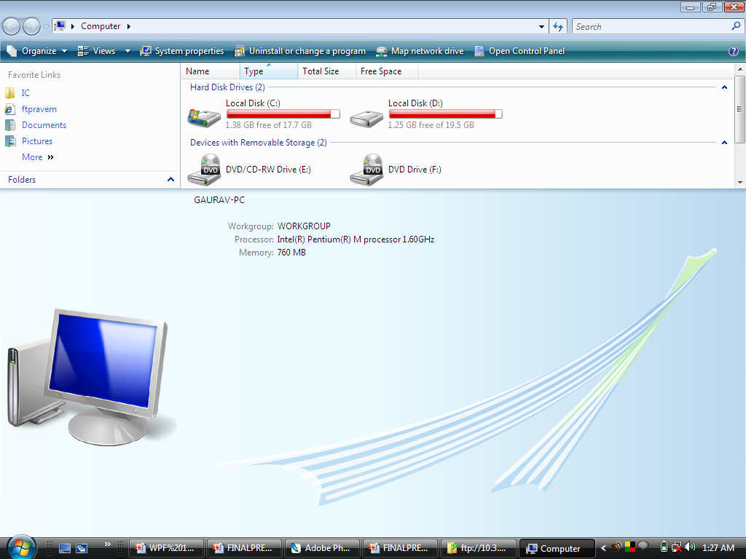








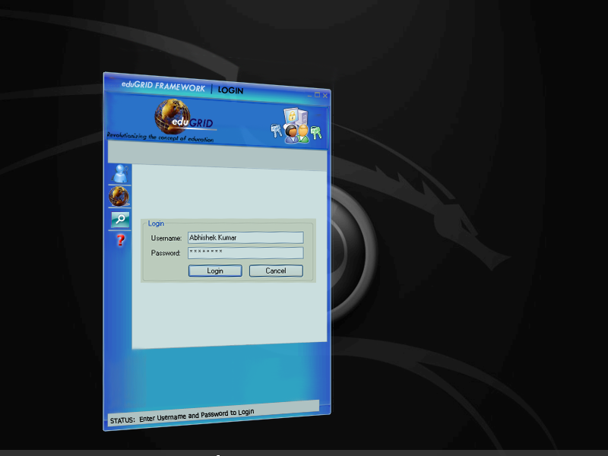



User
Users :
The target users of eduGRID are:
Students
Teachers
Other General Users
BizTalk
eduGRID site
eduGRID client
Manager
eduGRID Architecture
Generic Executor Pool
Specialized Executor Pool

Slide 5
User
eduGRID site
BizTalk
eduGRID site
BizTalk
eduGRID client
eduGRID client
Manager
Generic Executor Pool
Specialized Executor Pool

Slide 6
User
The Grid:
The eduGRID framework consists of a network of computers connected to each other through manager-executor nodes.
The web service provides users over the WWW an easy access to the grid infrastructure by acting as the broker between the user and the eduGRID framework. the web service is also responsible for authentication of the users.
The bot resides on the executor while the manager is responsible for job distribution.
The GRID distributes tasks/jobs using load balancing and the response from the executor - bot is routed back to the user through the central manager.
BizTalk
eduGRID site
eduGRID client
Manager
Generic Executor Pool
Specialized Executor Pool

Slide 7



USER
WEBSERVICE + INTERFACES
Grid Pool
eduGRID
Learn Assistant
Cache
Cache
The generic execution pool caches the most frequently used data to reduce the response time for these frequently requested data.
eduGRID Learn Assistant:
Microsoft Live Search: eduGRID makes use of Microsoft Live Search API in order to obtain latest and accurate information on frequently asked topics from the world wide web.

Slide 8

Working of the BOT
This system is an artificial intelligence entity, with the power of NLP.
e.g.
<aiml>
<category><pattern>ASL</pattern><template><bot name="age"/>/<bot name="gender"/>/<bot name="location"/>.</template></category>
<category><pattern>WHAT IS YOUR FAVORITE COLOR</pattern><template>My favorite color is <bot name="favoritecolor"/>. What is yours?</template></category>
<category>
<pattern>WHAT SPECIES ARE YOU</pattern>
<template>I am a <bot name="species"/>.</template>
</category>
<category><pattern>HOW LONG IS YOUR HAIR</pattern><template><bot name="hair"/></template></category>
<category><pattern>YOU ARE BEING *</pattern><template>I am I am only as <person/> as the average <bot name="genus"/>.</template></category>
<category>
</aiml>
What is …?
Logical
Reasoning
Module
What do you mean by…?
INPUT/OUTPUT INTERFACES
Text
Voice
Natural Language
Processing
Module
STUDENT
Answer is …
General Knowledge KB
Subject Specific KB
Schematic Diagram of Bot Design
User Profile

Slide 9

Privacy Policy
Project eduGRID does not violate privacy policy whereby information from the user shall not be shared with other users without prior permission of the user. The bot learns from the user through its intelligent conversations keeping in mind the discretion of the user.

Slide 10

Business Model
eduGRID applications provide innovative business models for our projects. Some of these include:
“Automated Helpdesk or Intelligent Assistant”
Educating employees within an organisation (orientation)
Intelligent Advertising without violating privacy policy
Teacher / Faculty can work for free or for a charge, hence providing “a source of revenue”
Specialised bots for people in different professions

Slide 11

Thanking you
eduGRID will revolutionize the way in which education is provided.
For centuries, mankind has taught itself, but now what if the computer became the teacher ?

